Slide 1
The Dangers of Sensitive Sectors in FTAs
Alan V. Deardorff
University of Michigan
Lecture 3
Nankai University
March 1, 2016

Slide 2
One More Mega-FTA
TFTA: Tripartite Free Trade Area
26 countries in Africa
EAC: East African Community
SADC: Southern African Development Community
COMESA: Common Market for Eastern and Southern Africa

Slide 3
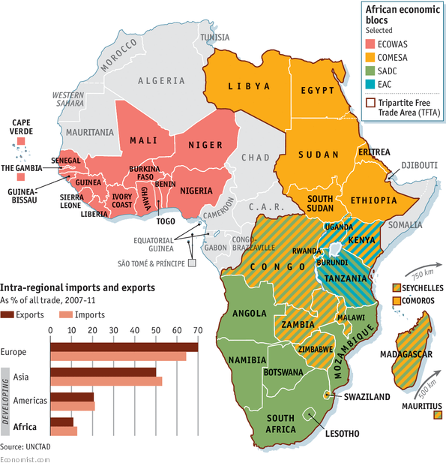

Slide 4
Pros and Cons of all FTAs
Preferential tariff cuts
Pro: trade creation
Similar to the classic “gains from trade”
Cons:
Trade diversion
Rules of origin (ROOs)
Exemption of sensitive sectors
Sensitive = Most likely to be trade-creating if included

Slide 5
Effects of FTAs
Market-diagram Illustration
Suppose Country A can import a good from either Country B or Country C at prices
P_{C} < P_{B}
And Country A has a tariff greater than the price difference:
t > (P_{B} − P_{C})
What happens when Country A forms a PTA with high-cost Country B, lowering its tariff to zero on imports from Country B?

Slide 6
Effects of FTAs
Before FTA
Market in Country A
P
P_{C}+t < P_{B}+t, so
S^{A}
P_{B}+t
A imports from C
P_{C}+t
With FTA
P_{B}
P_{B}< P_{C}+t, so
P_{C}
A imports from B
D^{A}
Q

Slide 7
Effects of FTAs
Market in Country A
FTA of Country A and Country B:
P
S^{A}
Trade Creation
P_{C}+t
a
c
Welfare effects
Producers lose −a
Consumers gain +(a+b+c+d)
Gov’t loses −(c+e)
Net +(b+d)−e
P_{B}
b
d
e
P_{C}
D^{A}
Q
Trade Diversion

Slide 8
Effects of FTAs
Market in Country A
FTA of Country A and Country B:
P
S^{A}
Trade Creation
P_{C}+t
a
c
Implication:
Country A can lose from the FTA in this market, if
e > (b+d)
(as it is in this picture)
P_{B}
b
d
e
P_{C}
D^{A}
Q
Trade Diversion

Slide 9
Effects of FTAs
Sensitive sectors
Area a is
The loss to producers
Part of the gain to consumers
The main reason why a sector would lobby to be named “sensitive” and excluded from the tariff cut on country B
See how it, and the gains and losses from PTA, varies with changing costs:

Slide 10
Market in Country A
Higher P_{C}
P
P
S^{A}
S^{A}
P_{C}+t
P_{C}+t
a
c
a
c
P_{B}
b
d
P_{B}
b
d
e
e
P_{C}
P_{C}
D^{A}
D^{A}
Q
Q
Higher price in outside country C (but still lower than price in partner, B:
Increases Sensitivity, increases trade creation, reduces trade diversion.

Slide 11
Market in Country A
Lower P_{B}
P
P
S^{A}
S^{A}
P_{C}+t
P_{C}+t
a
c
a
c
P_{B}
b
d
b
d
e
P_{B}
P_{C}
P_{C}
e
D^{A}
D^{A}
Q
Q
Lower price in inside country B (but still higher than price in outside, C:
Increases Sensitivity, increases trade creation, reduces trade diversion.

Slide 12
Effects of FTAs
Sensitive sectors
Thus the sectors that are most likely to claim that they are “sensitive” due to large losses from the PTA are also the ones that would have
The greatest gain from trade creation
The smallest loss from trade diversion
My fear is that if proliferating FTAs allow too many sensitive sectors, the gains will be squeezed out leaving only the losses.

Slide 13
Pros and Cons of all FTAs
Other aspects of actual FTAs
Pros:
Extension to trade in services
Harmonization of regulations
Cons (?):
Extension of IP protection
Trade enforcement of labor standards
Trade enforcement of environmental standards
Investor-State Dispute Settlement

Slide 14
Additional Pros and Cons of Mega-FTAs
Preferential tariff cuts
Pros:
Larger potential for trade creation
If ROOs are cumulative, less distorting
Potential for adding members
Replace multiple rules with a single set
Cons:
Though there are fewer outsiders, each is harmed more by trade diversion
In fact (in TPP) there is more complexity

Slide 15
Additional Pros and Cons of Mega-FTAs
Other aspects of actual Mega-FTAs
Pros:
May contribute to broader and more uniform standards
Cons:
Their use as weapons of geopolitics

Slide 16
Implications of Mega-FTAs for the WTO
Might have created pressure to complete Doha Round.
Possible, just as NAFTA motivated Uruguay Round
Didn’t happen; Round is dead.

Slide 17
Implications of Mega-FTAs for the WTO
By lowering trade barriers regionally, Mega-FTAs will
Hasten the decline of uncompetitive industries,
Thus gradually reduce political forces for protection
This may reduce the need to use WTO-sanctioned administrative protection (anti-dumping, etc.)

Slide 18
Implications of Mega-FTAs for the WTO
Trade disputes will have alternative fora in which to be settled: Choice between WTO panels and FTA panels
This may lessen the role of the WTO Dispute Settlement Mechanism
But it will remain relevant

Slide 19
Implications of Mega-FTAs for the WTO
WTO will continue to be important for plurilateral negotiations on issues that transcend the Mega-FTAs
Some issues that lend themselves neither to plurilateral agreements not to Mega-FTAs will remain unresolved
Most important: Subsidies

Slide 20
Implications of Mega-FTAs for China
China must decide which Mega-FTAs
To join (TPP)
To create (RCEP)
To push for (FTAAP = Free Trade Area of Asia and the Pacific)
Will China seek to use FTAs to
Wall itself off from other major countries?
Or join in economic integration with other major countries?

Slide 21
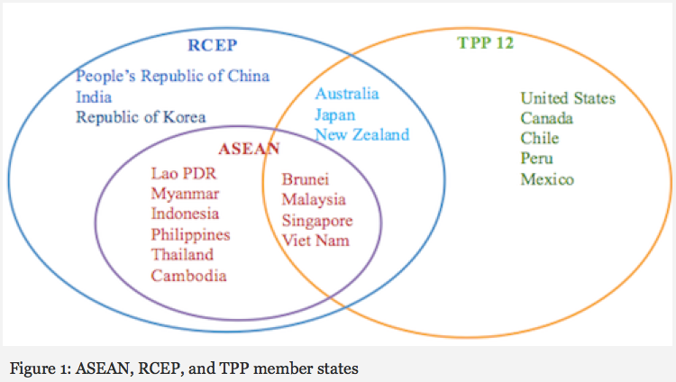
Notes:
http://asiafoundation.org/in-asia/2015/09/09/tpp-and-rcep-boon-or-bane-for-asean/

Slide 22
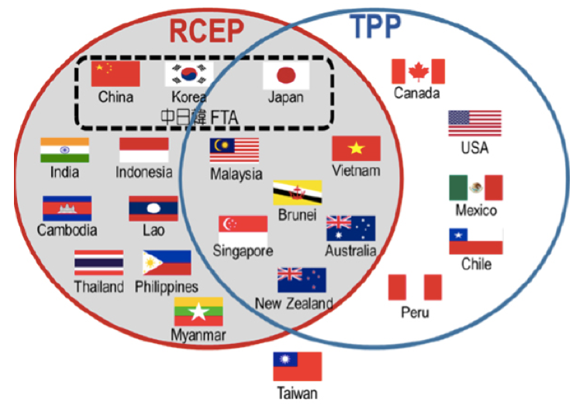
Notes:
http://www.postwesternworld.com/2015/08/21/tussle-regional-influence/

Slide 23
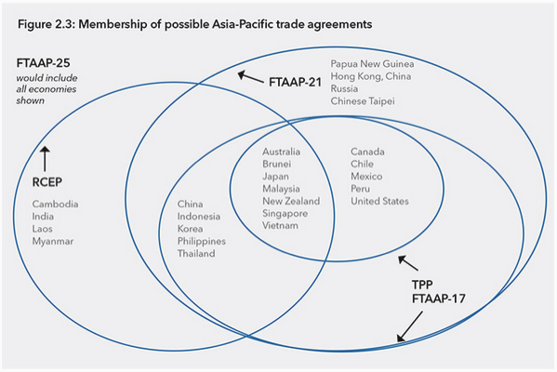
Notes:
http://www.pecc.org/state-of-the-region-report-2014/265-state-of-the-region/2014-2015/595-chapter-2-can-rcep-and-the-tpp-be-path-ways-to-ftaap

Slide 24
Implications of Mega-FTAs for China: TPP
If China does not join TPP
Will suffer from trade diversion in countries without China FTAs
US, Japan
Others
Will suffer from trade diversion due to ROOs even in countries with China FTAs
Chile, Peru, members of ASEAN

Slide 25
Implications of Mega-FTAs for China: TPP
If China does not join TPP
Will not be subject to non-trade requirements of TPP
State owned enterprises
Labor Standards
Environment
May not need to open trade as much as TPP requires

Slide 26
Implications of Mega-FTAs for China: RCEP
If RCEP, including China, succeeds
Minimal trade creation/diversion, since China already has FTAs with ASEAN and some other RCEP members
S Korea
New Zealand
Largest effect will be FTA with Japan
Some trade creation
Reversal of prior trade diversion from Japan’s other FTAs, including TPP.

Slide 27
Implications of Mega-FTAs for China: RCEP
If RCEP, including China, succeeds
If it cumulates rules of origin, RCEP will reduce trade and investment diversion due to ROOs.
Though initiated by ASEAN, RCEP will be viewed as a political triumph of China in building a China-centered economic bloc.

